Slide 1
Style Transfer
Team Athenians
Pranav Kirsur: 2018101070
Avani Gupta: 2019121004
Pranav Tadimeti: 2018101055
Nivedita Rufus: 2019702002
Mentor TA: Gowri Lekshmy

Slide 2
Overview
Objectives
Transfer any arbitrary visual styles to content images (Style Transfer)
Allow user control on the amount of stylization.
Challenges
Preserving the actual content of the image, efficiency, quality of the output images

Slide 3
Universal Style Transfer via Feature Transforms
The paper Universal Style Transfer via Feature Transforms applies feature transforms like whitening and coloring which are further embedded to an image reconstruction network in order to perform style transfer on images.
Li, Y., Fang, C., Yang, J., Wang, Z., Lu, X., & Yang, M. H. (2017).
arXiv preprint arXiv:1705.08086.

Slide 4
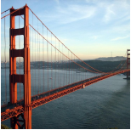
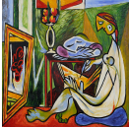
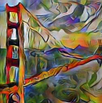
Goal
Content
Style
Resultant image

Slide 5
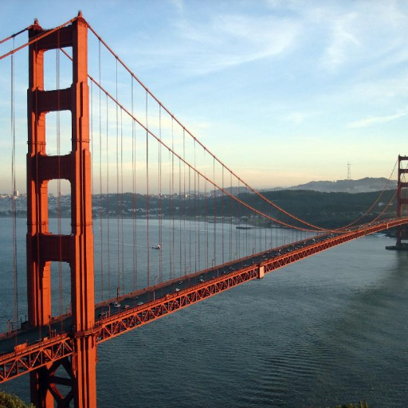
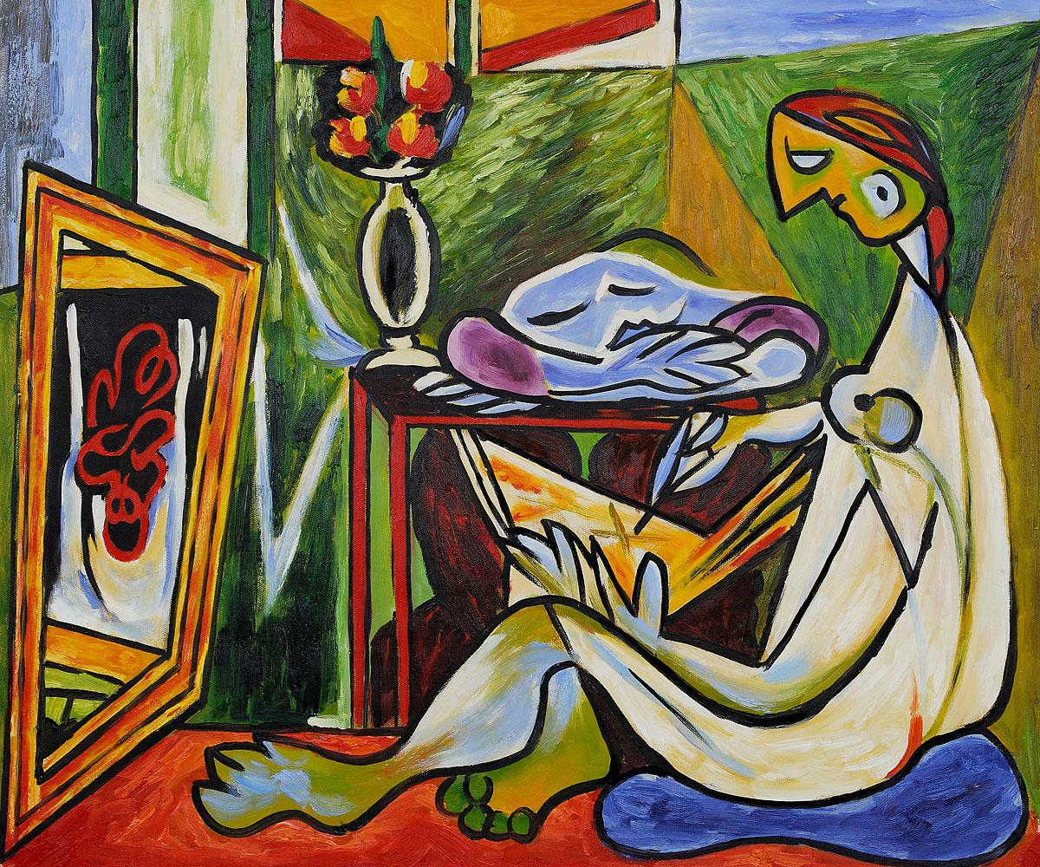
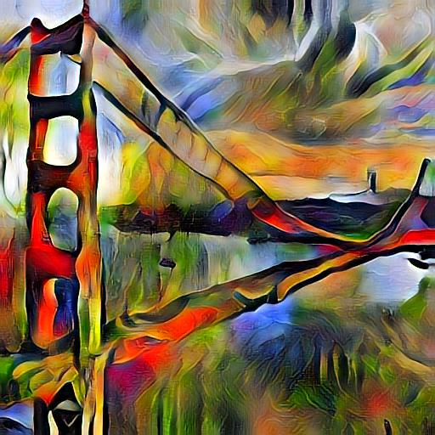
Our Result
Content
Style
Resultant image

Slide 6
Methodology
The paper proposes to use feature transforms: whitening and coloring to directly match content feature statistics to those of a style image.
The feature transforms are coupled with a pre-trained general encoder-decoder network, so that the transfer is done via feed-forward operations.
Thus they do style transfer via an image reconstruction process coupled with feature transformations as above.
The reconstruction part is responsible for inverting features back to the RGB space and the feature transformation matches the statistics of a content image to a style image.

Slide 7
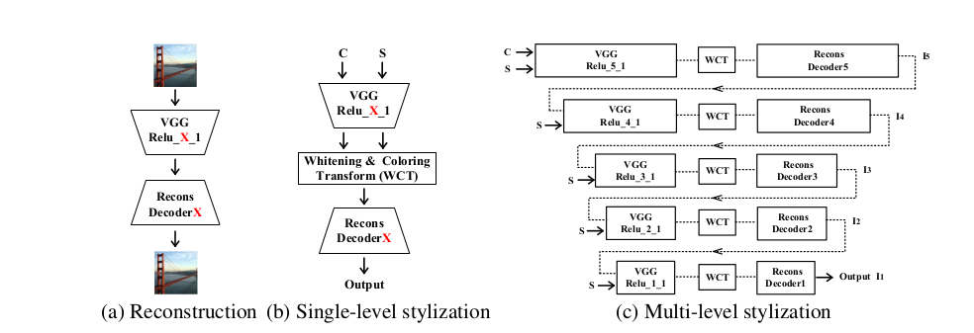
Pipeline

Slide 8
Pipeline (contd.)
Pre-train five decoder networks Decoder (X=1,2,...,5) through image reconstruction to invert different levels of VGG features.
With both VGG and Decoder X fixed, and given the content image C and style image S, perform the style transfer through whitening and coloring transforms.
Extend single-level to multi-level stylization in order to match the statistics of the style at all levels.
The result obtained by matching higher level statistics of the style is treated as the new content to continue to match lower-level information of the style.

Slide 9
Reconstruction Decoder
VGG-19 used as an encoder.
Decoder network is trained for inverting VGG features to the original image.
Designed as being symmetrical to VGG-19 network (up to Relu_X_1 layer), with the nearest neighbor upsampling layer used for enlarging feature maps.
Pixel reconstruction loss and feature loss are employed for reconstructing an input image.

Slide 10
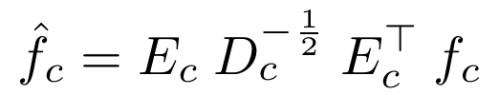
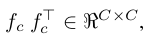
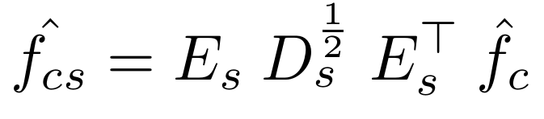
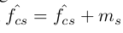
Feature Transforms
Extract vectorized VGG features maps f_{c} and f_{s} from content image and style image respectively.
Then we apply Whitening and coloring transforms as follows:
Whitening Transform
Where D_{c} is the diagonal matrix with the eigenvalues of the covariance matrix
and E_{c} is the corresponding orthogonal matrix of eigenvectors, satisfying
Coloring Transform
Where D_{s} and E_{s} are calculated in same manner as above.

Slide 11
Multi-level coarse-to-fine stylization
Features of deeper layers capture more complicated local structures.
Features of initial layer carry more low-level information.
Apply WCT at latter layer to obtain coarse stylized image and consider it as new content image to further adjust features in initial layers.

Slide 12
User Controls
User can control scale, weight and spatial features of style:
Scale can be controlled by varying size of input style image.
Spatial control is provided via masks for specific regions and styles.
Weight is controlled by the style weight α in the feed-forward passes

Slide 13
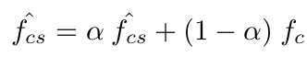
User Controls
The style input on different scales will lead to different extracted statistics due to the fixed receptive field of the network.
Spatial control can be achieved through user provided masks, with different styles on different parts of the image.
The weight (1-α) controls how much of the content features are retained.

Slide 14
Work done till mid - eval
Single Level Stylisation
Modules coded:
Dataloader
Reconstruction Decoder
WCT transforms

Slide 15
Work done after mid - eval
Completed full multi-level pipeline
Added user control:
Scale
Spatial control
Weight

Slide 16
Method of Experimentation
Tried stylisation on various style and content images combinations.
Kept style constant and varied content image.
Kept content image constant and varied styles.
Tried user control though scale, spatial control through masks, and different weights(values of alpha)

Slide 17
Single Level Stylization
Results

Slide 18
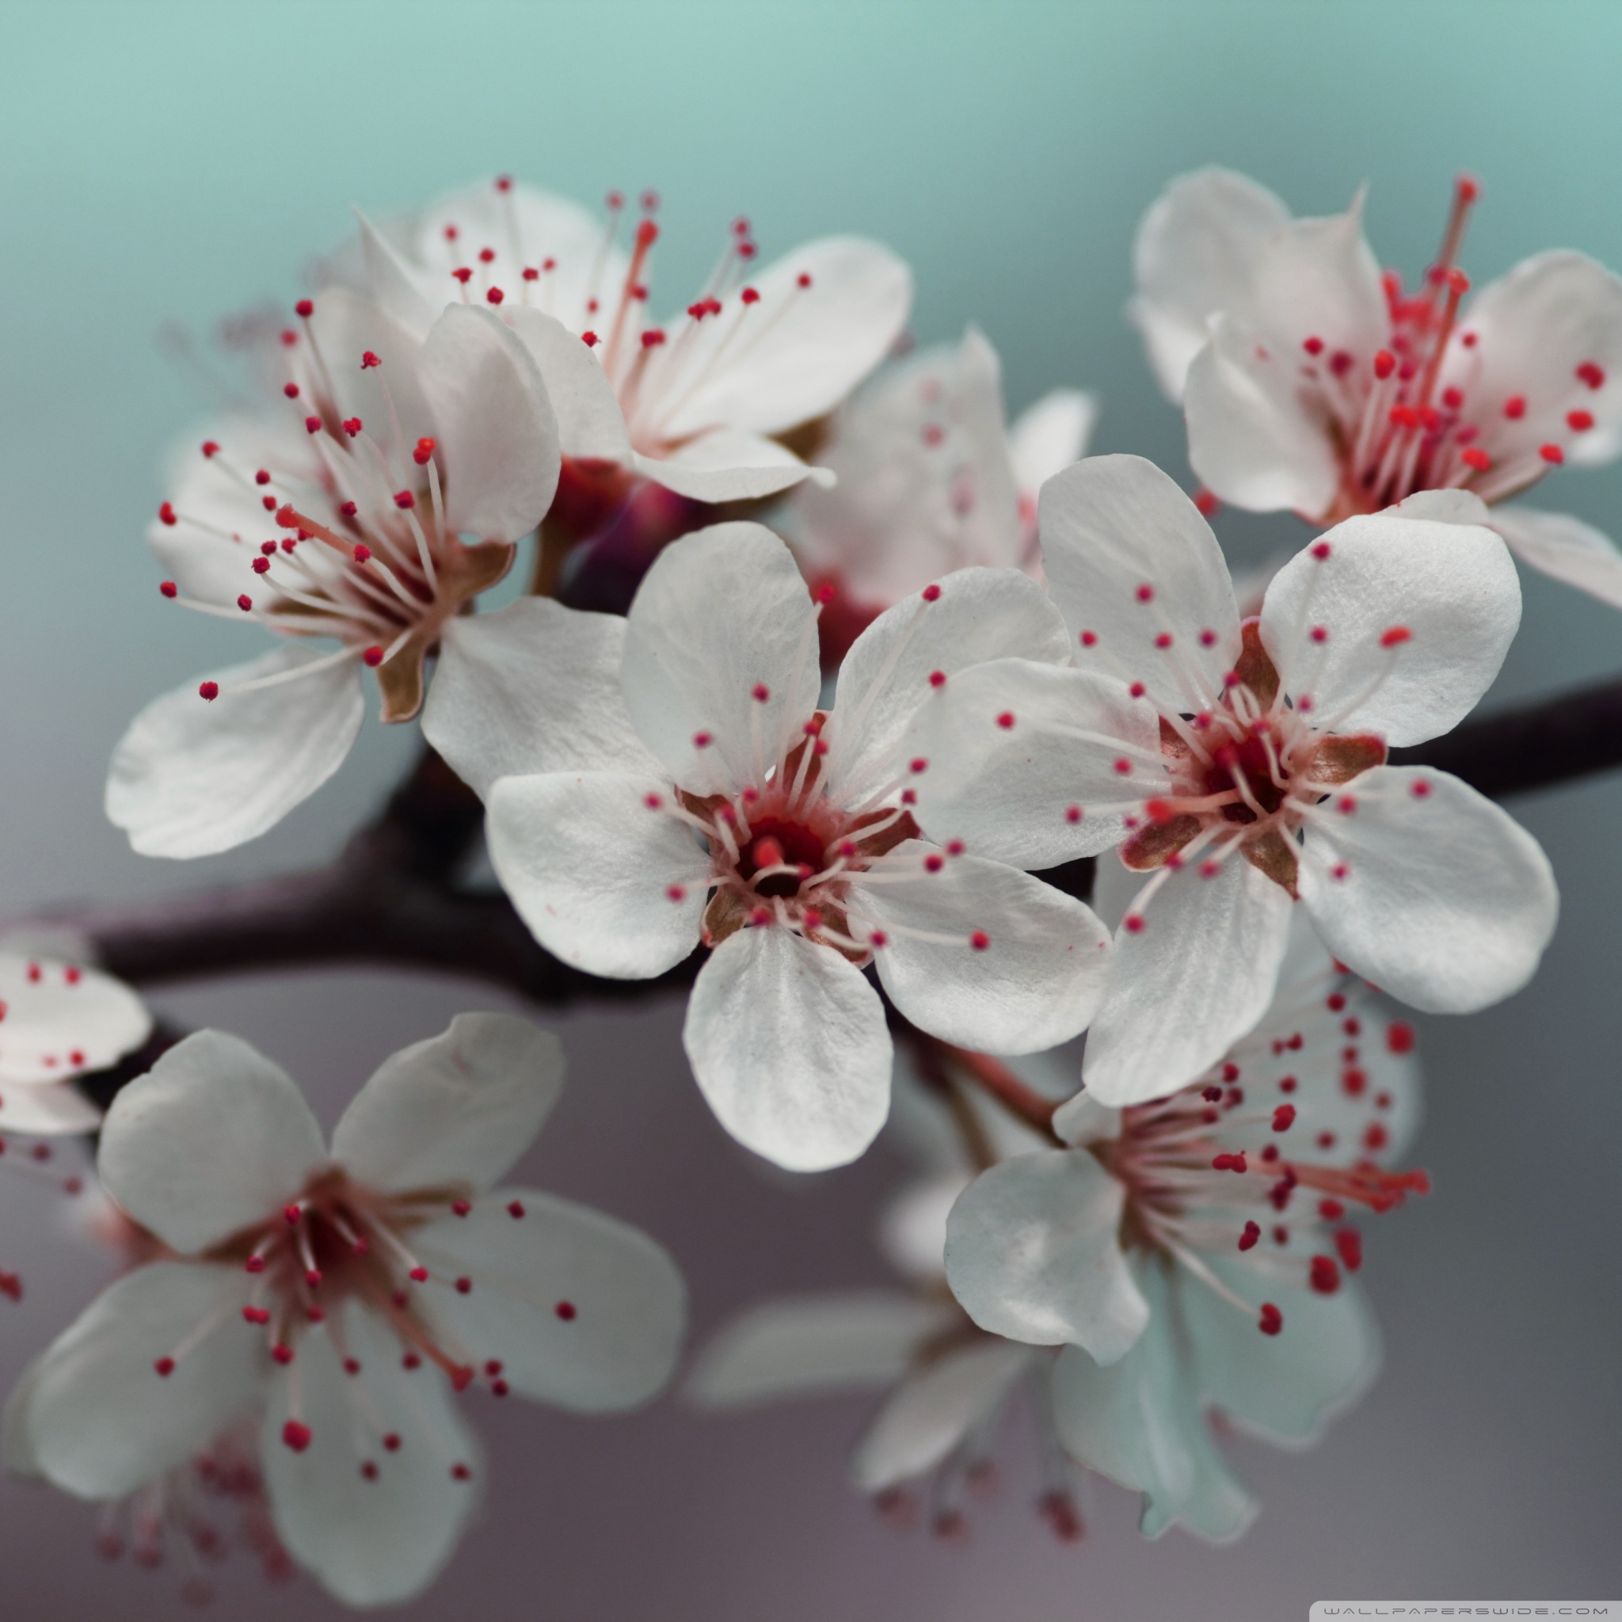
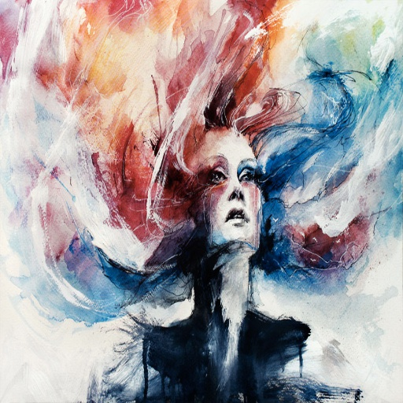
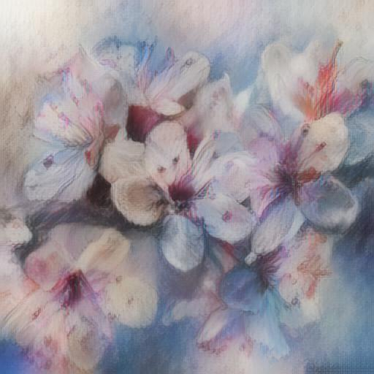
Content Image
Style
Transformed image

Slide 19
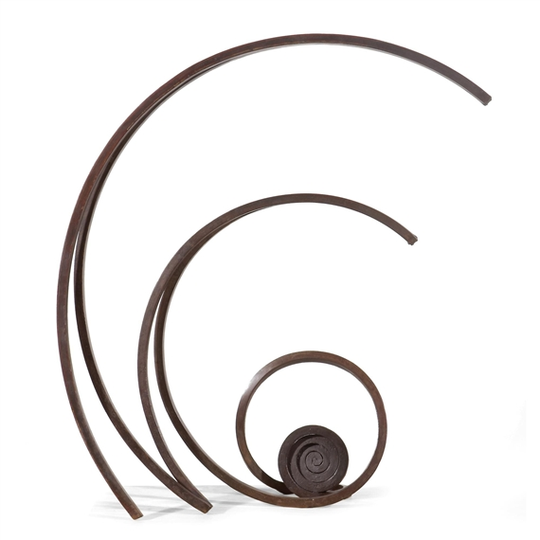
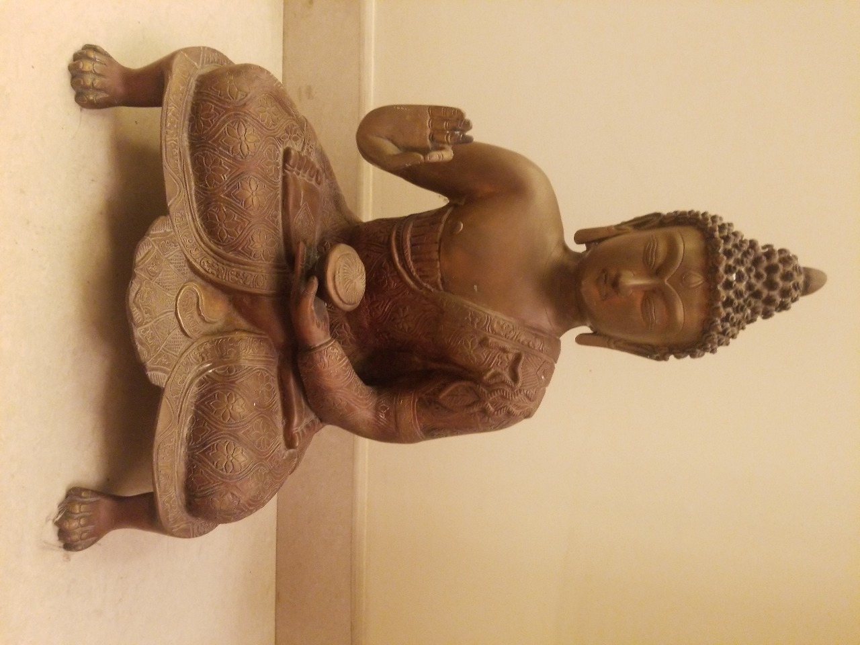
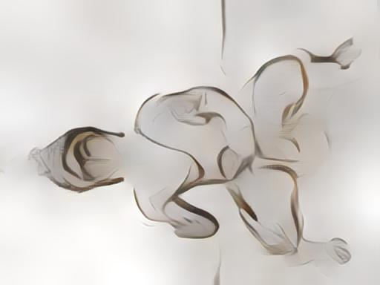
Content Image
Style
Transformed image

Slide 20
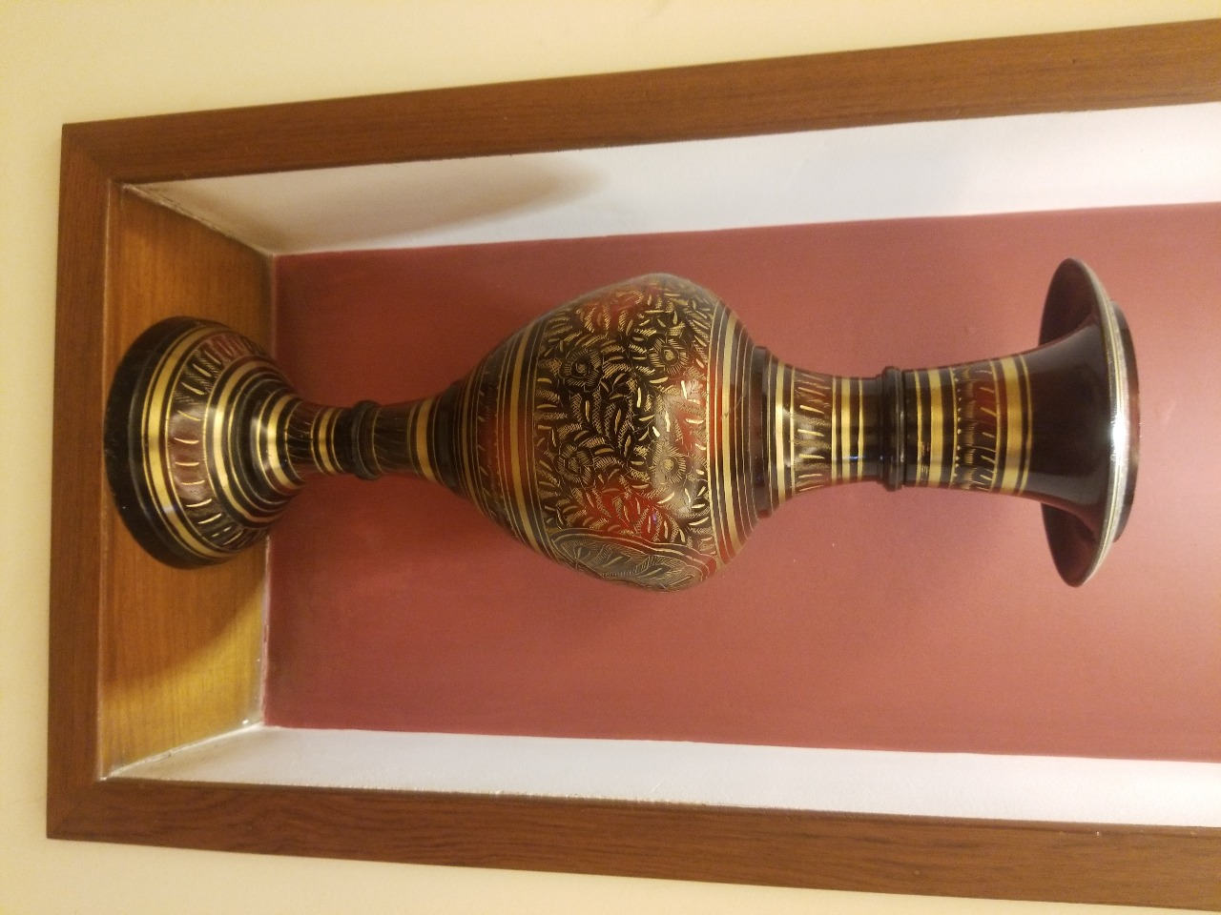
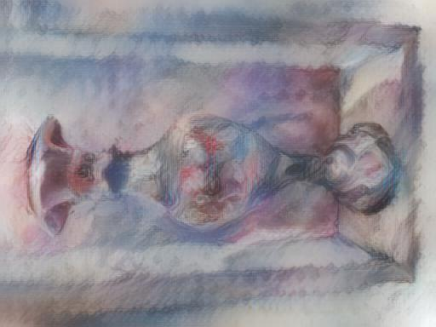
Content Image
Style
Transformed image

Slide 21
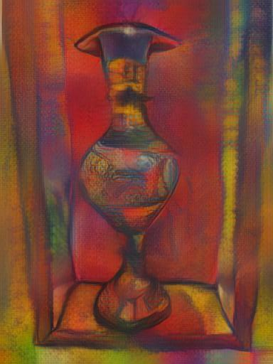
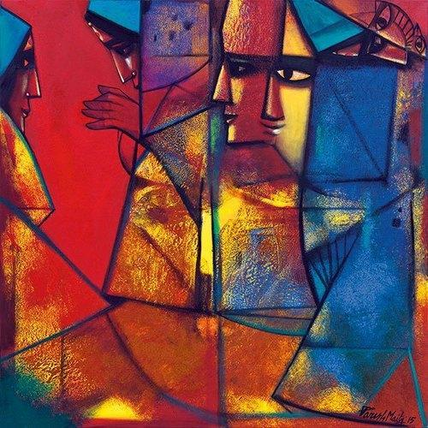
Content Image
Style
Transformed image

Slide 22
Multi Level Stylization Results
Notes:
The style input on different scales will lead to different extracted statistics due to the fixed receptive field of the network. Therefore the scale control is easily achieved by adjusting the style image size.

Slide 23

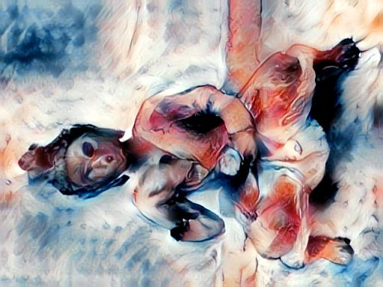
Content Image
Style
Transformed image

Slide 24
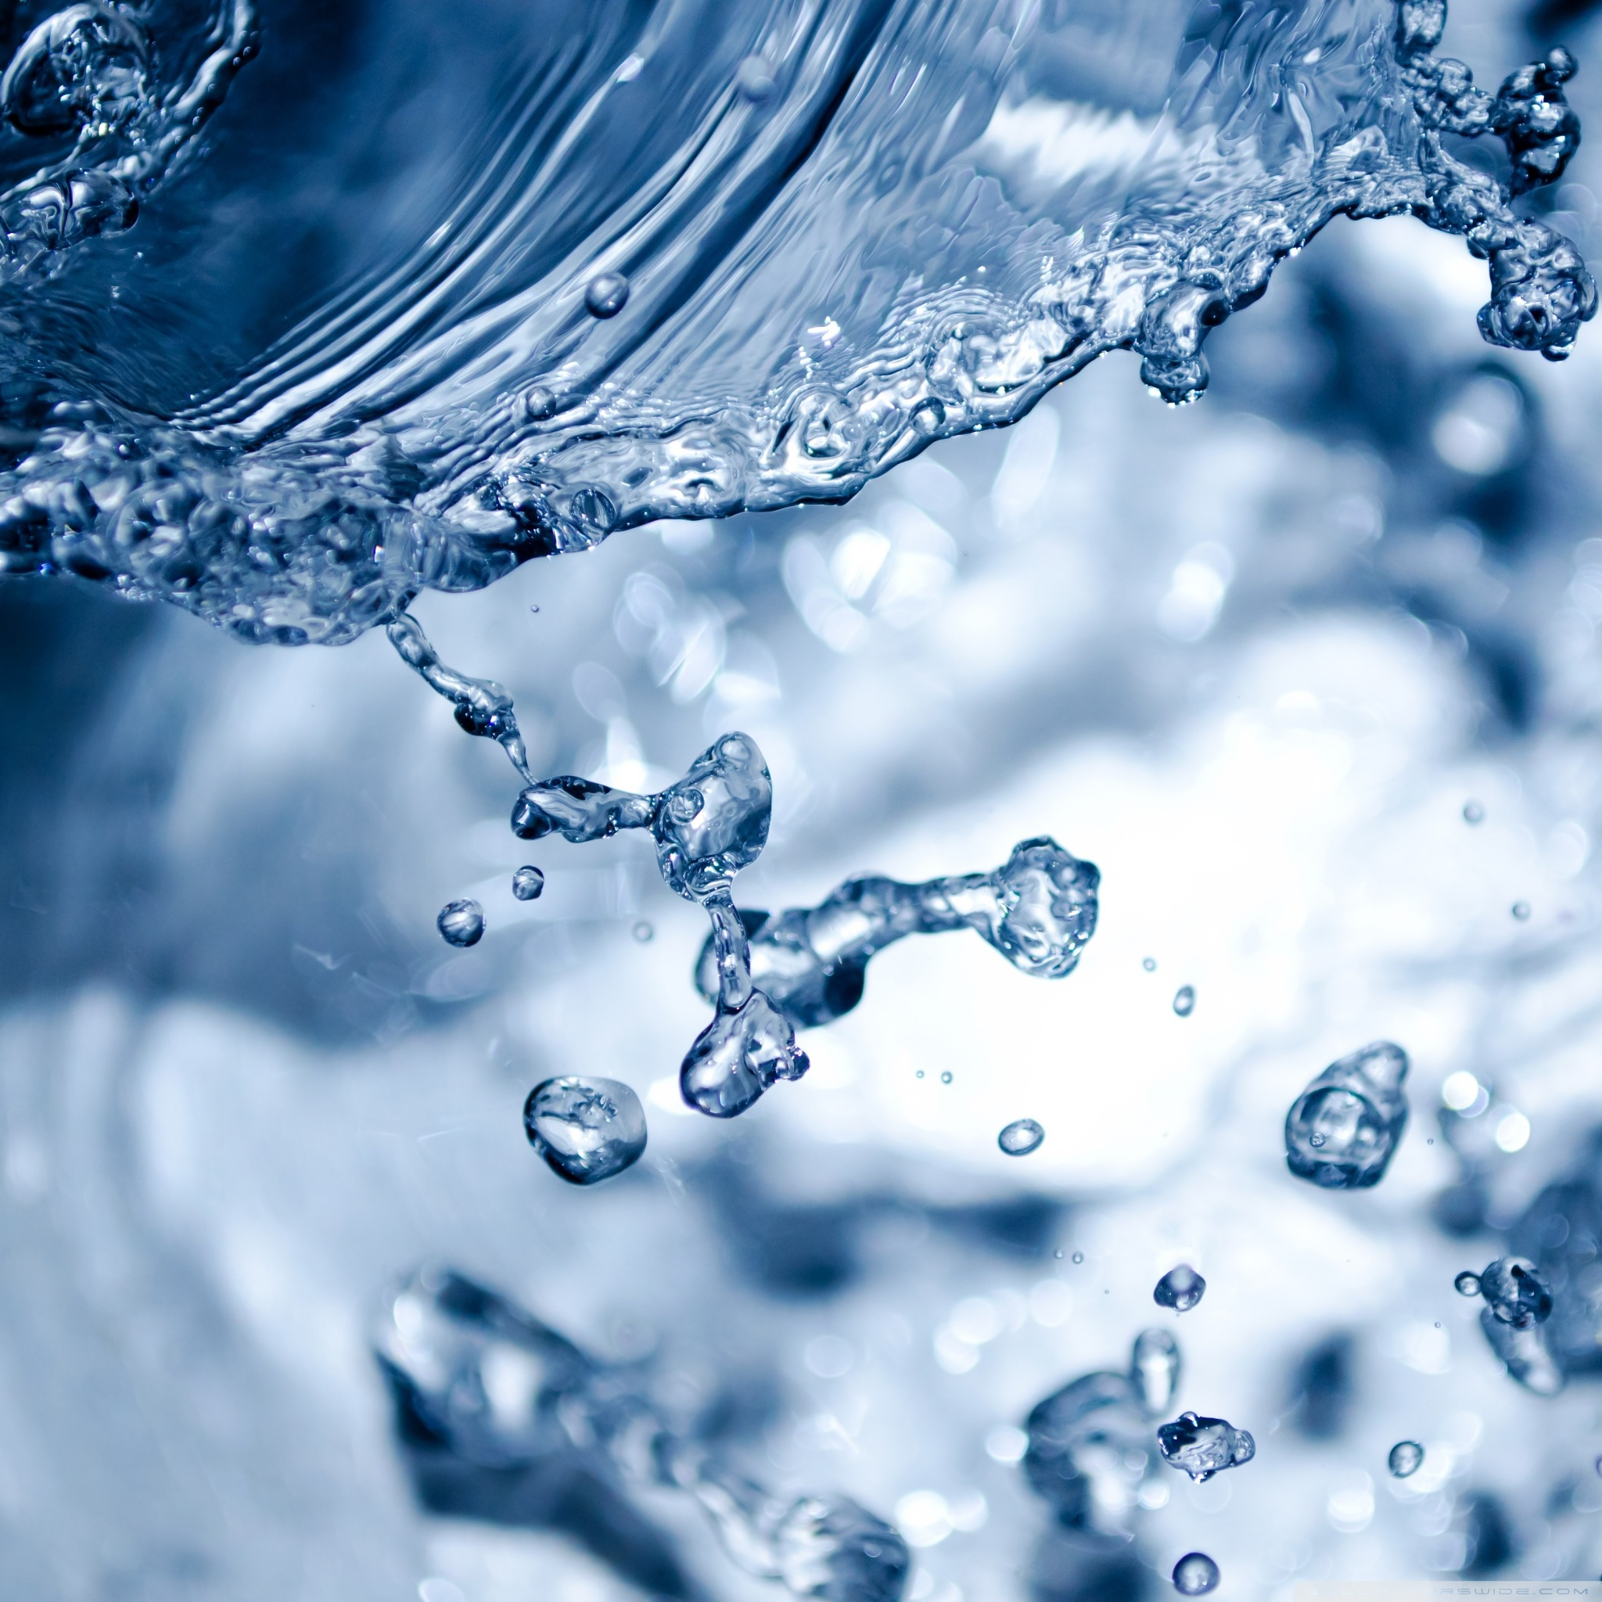

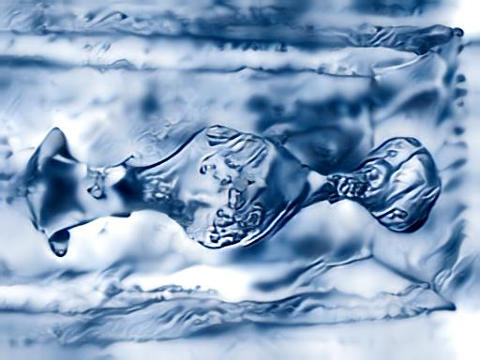
Content Image
Style
Transformed image

Slide 25

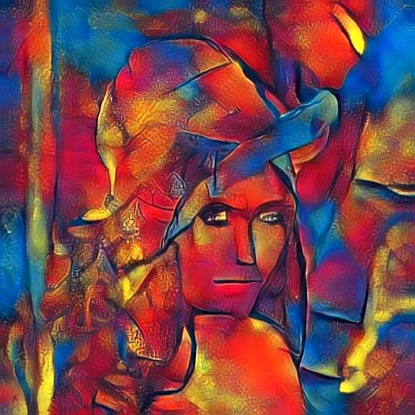
Content Image
Style
Transformed image

Slide 26
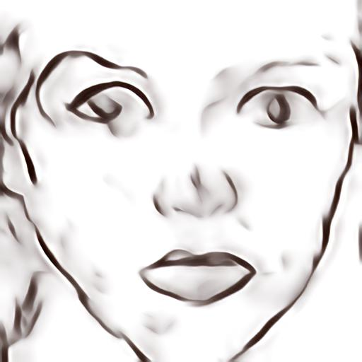
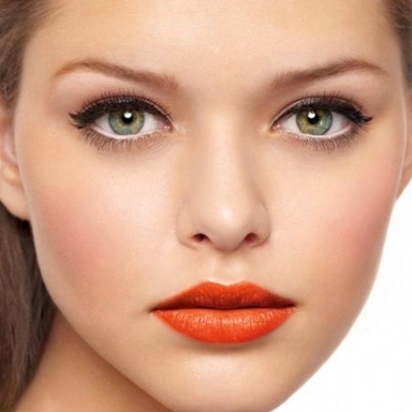

Content Image
Style
Transformed image

Slide 27
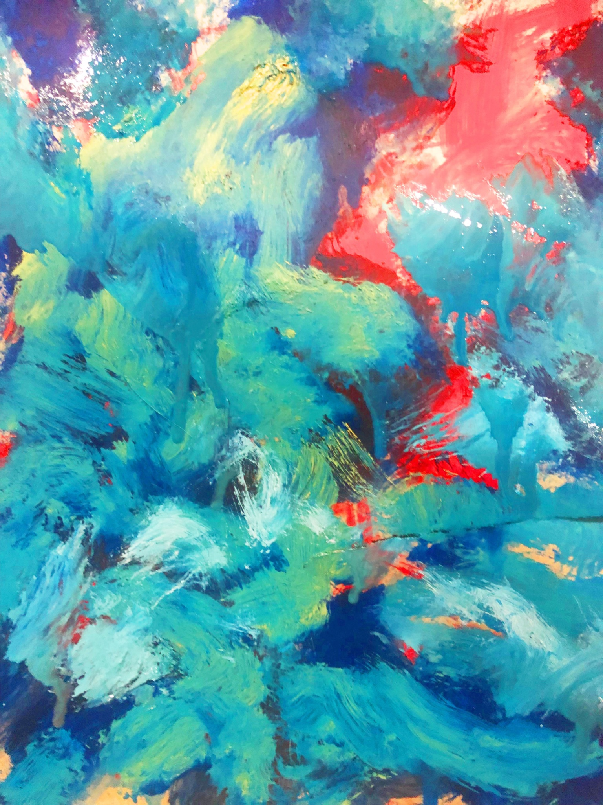
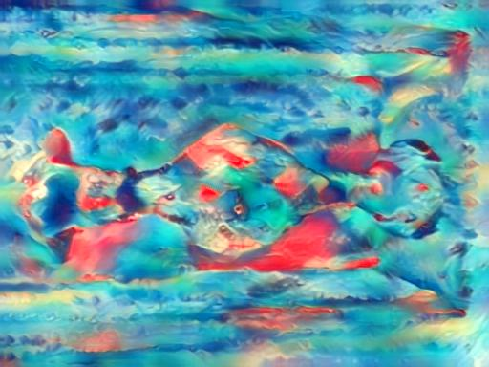
Content Image
Style
Transformed image

Slide 28
Comparing Single Level and Multi Level Stylization Results
Notes:
The style input on different scales will lead to different extracted statistics due to the fixed receptive field of the network. Therefore the scale control is easily achieved by adjusting the style image size.

Slide 29
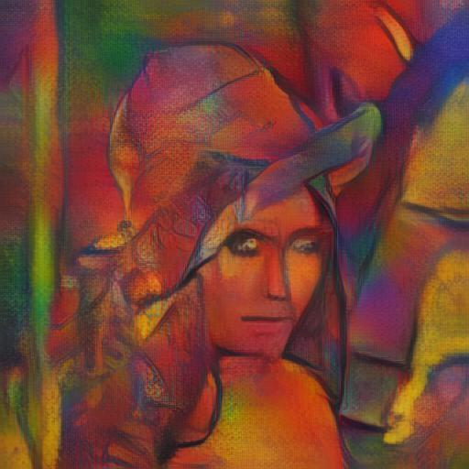
Single Level
Multi
Level

Slide 30
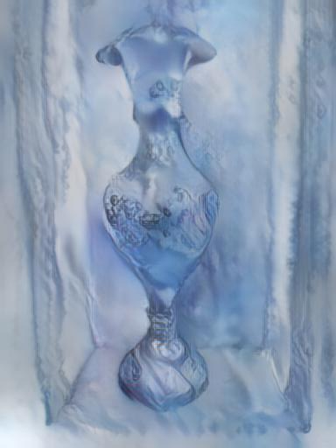
Single Level
Multi
Level

Slide 31
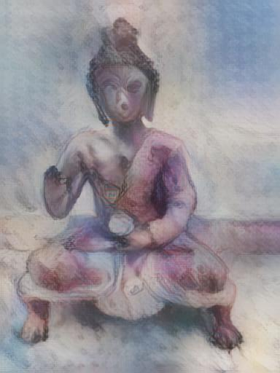
Single Level
Multi
Level

Slide 32
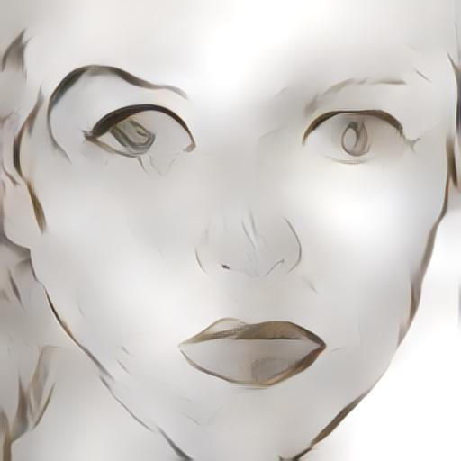
Single Level
Multi
Level

Slide 33
Vary the scale of style image: basically change size of style image
Experiment:
Notes:
The style input on different scales will lead to different extracted statistics due to the fixed receptive field of the network. Therefore the scale control is easily achieved by adjusting the style image size.

Slide 34
For Single Level stylization
Notes:
The style input on different scales will lead to different extracted statistics due to the fixed receptive field of the network. Therefore the scale control is easily achieved by adjusting the style image size.

Slide 35
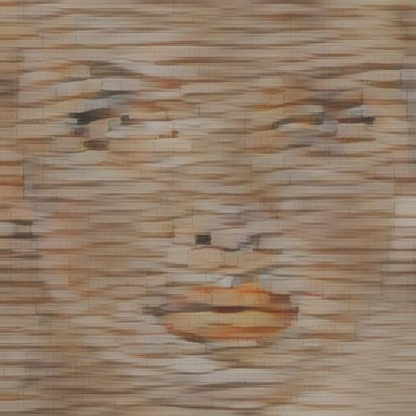
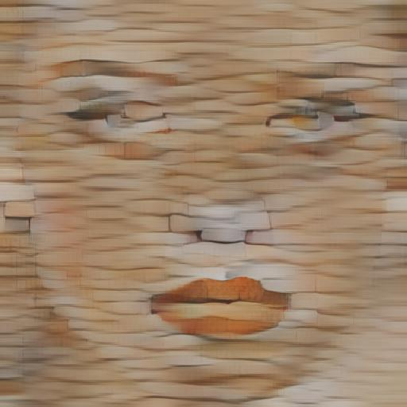
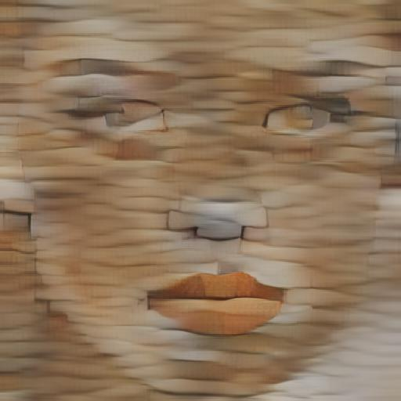
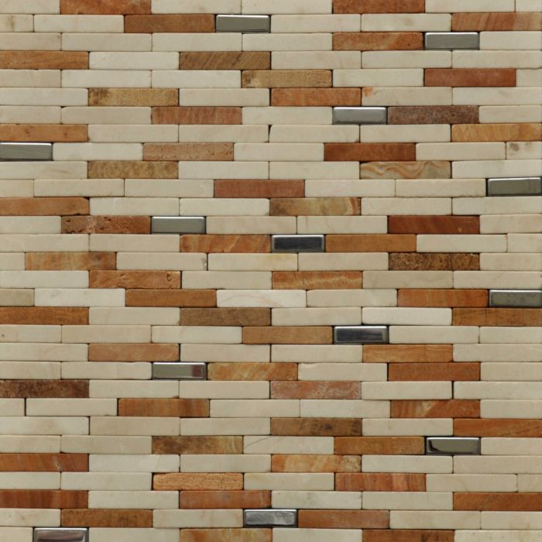
Content Image
scale:
256
Style
512
768

Slide 36
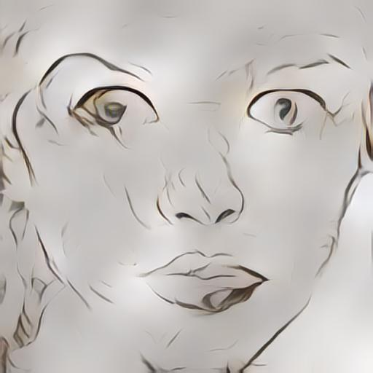
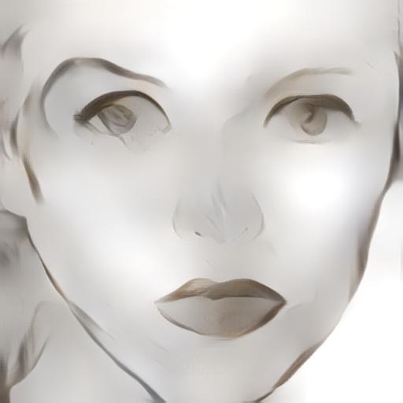
Content Image
scale:
256
Style
512
768
Notes:
As seen the details of style are decreased and image becomes smoother as scale of style image is increased.

Slide 37
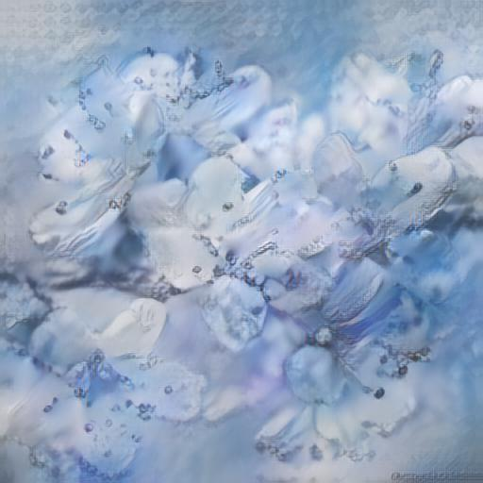
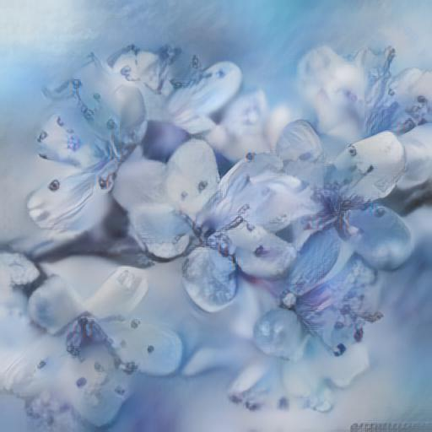
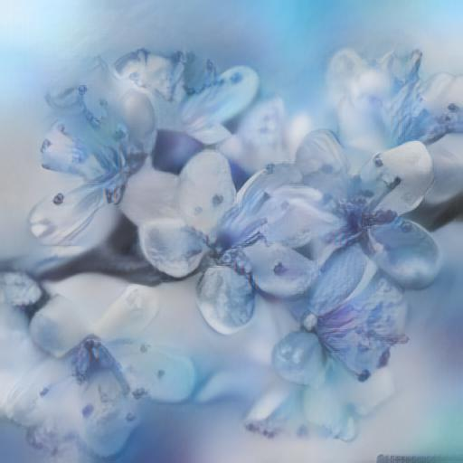
Content Image
scale: 256
Style
512
768

Slide 38
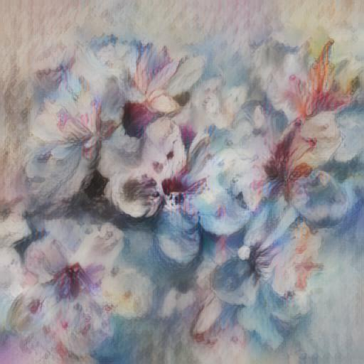
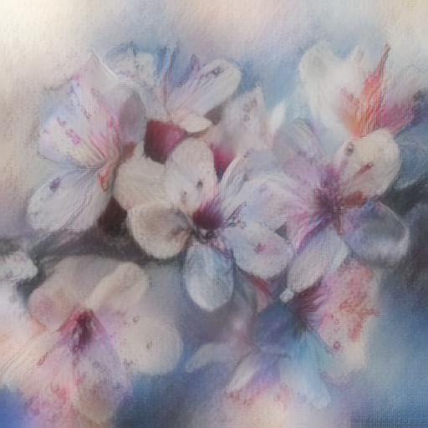
Content Image
scale: 256
Style
512
768

Slide 39
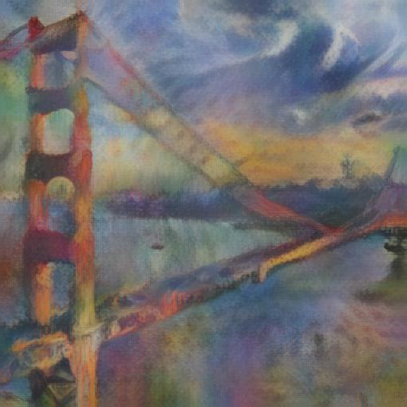
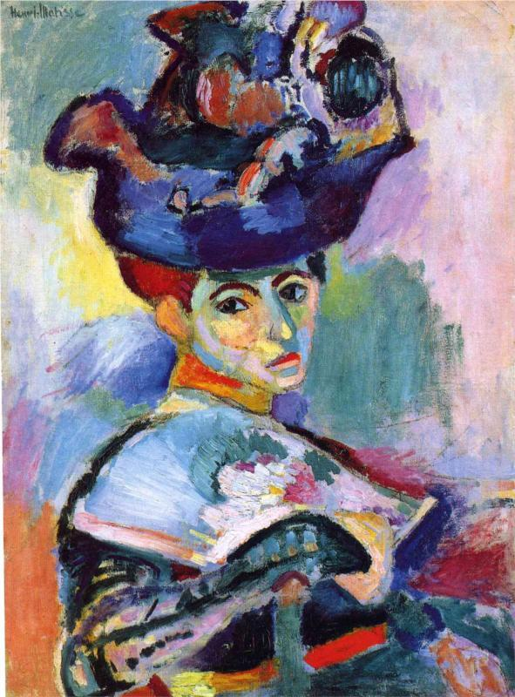
Content Image
scale: 256
Style
512
768

Slide 40
For Multi-Level stylization
Notes:
The style input on different scales will lead to different extracted statistics due to the fixed receptive field of the network. Therefore the scale control is easily achieved by adjusting the style image size.

Slide 41
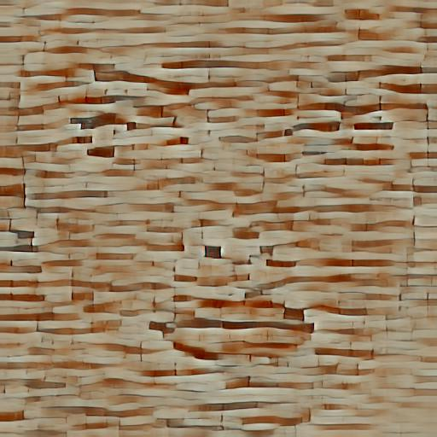
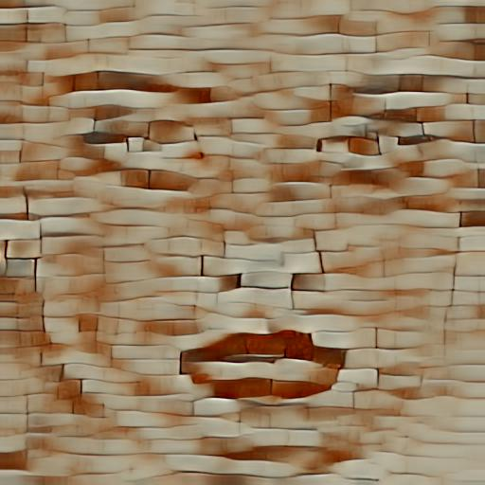
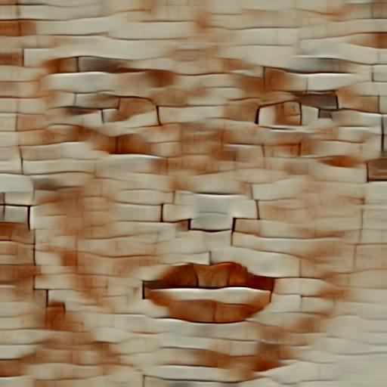
Content Image
scale:
256
Style
512
768

Slide 42



Content Image
scale:
256
Style
512
768
Notes:
As seen the details of style are decreased and image becomes smoother as scale of style image is increased.

Slide 43



Content Image
scale: 256
Style
512
768

Slide 44



Content Image
scale: 256
Style
512
768

Slide 45


Content Image
scale: 256
Style
512
768

Slide 46
Spatial Control provided via masks
Notes:
The style input on different scales will lead to different extracted statistics due to the fixed receptive field of the network. Therefore the scale control is easily achieved by adjusting the style image size.

Slide 47

Content Image
Style
Transformed image

Slide 48

Content Image
Style
Transformed image

Slide 49



Content Image
Style
Transformed image
Mask

Slide 50
Changing the weight of style image (alpha)
Notes:
The style input on different scales will lead to different extracted statistics due to the fixed receptive field of the network. Therefore the scale control is easily achieved by adjusting the style image size.

Slide 51


Alpha = 1
Alpha = 0.6
Alpha = 0.4

Slide 52



Alpha = 1
Alpha = 0.6
Alpha = 0.4

Slide 53



Alpha = 1
Alpha = 0.6
Alpha = 0.4

Slide 54



Alpha = 1
Alpha = 0.6
Alpha = 0.4

Slide 55
Frameworks and Libraries
Python (Pytorch)
OpenCV

Slide 56
Thank You!

